Slide 1
USTACKY CAPSTONE PROJECT
TOPIC: Nigeria-COVID-19-Data-Analysis-Using-Python

Slide 2
Project overview
This is an Exploratory Data Analysis of the recorded cases of the infectious Coronavirus disease in Nigeria. Nigeria recorded her first case of the deadly disease on February 27, 2020.

Slide 3
STEPS AND APPROACHES
Data Collection
Data was obtained and imported from different sources which include the NCDC website, John Hopkins Data Repository and the Ustacky repository.
Data Cleaning and Manipulation
The scraped Data was perfectly cleaned; check was done to ensure appropriate data types were used, columns were renamed and Data were saved to DataFrames for analytics process.
Data Analysis and Visualizations
The following plots were generated as analytics approach:
A plot that shows the Top 10 states in terms of Confirmed Covid-19 cases by Laboratory test.
A plot that shows the Top 10 states in terms of Discharged Covid-19 cases.
A line plot for the total daily confirmed, recovered and death cases.
The maximum infection rate for a day (Number of new cases) was calculated.

Slide 4
INSIGHTS SUMMARY
A bar chart showing the top 10 states in terms of Covid-19 cases confirmed by laboratory tests has Lagos at the top of the list.
Lagos state houses the Muritala Muhammed International Airport which is considered to be the Nigerian major airport as it welcomes all the international flights.

Slide 5
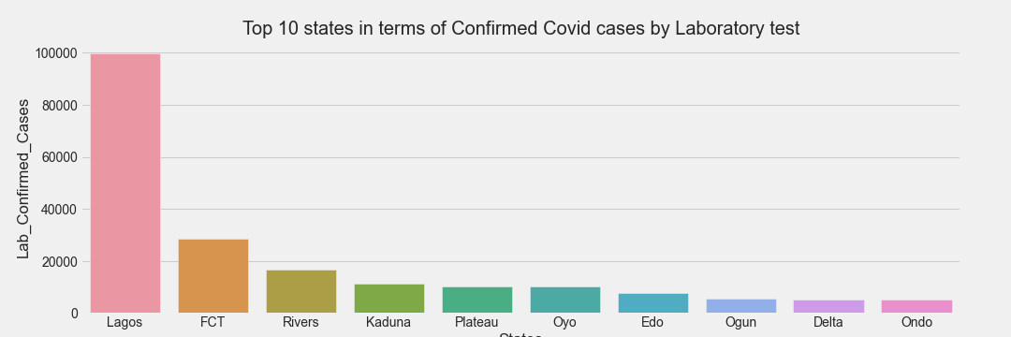
COVID-19 LABORATORY CONFIMED CASES BY TOP 10 STATES

Slide 6
INSIGHTS SUMMARY
A bar chart showing the top 10 states in terms of Covid-19 DISCHARGED cases also has Lagos at the top of the list.

Slide 7
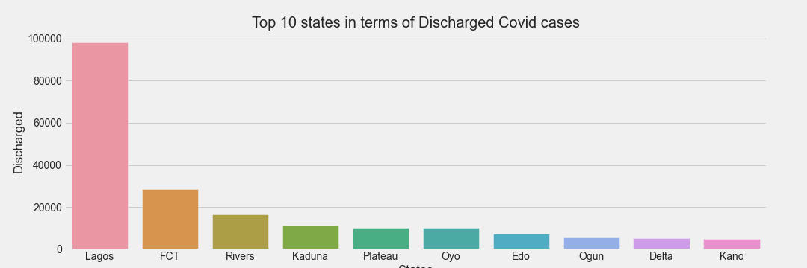
COVID-19 DISCHARGED CASES OF THE TOP 10 STATES

Slide 8
INSIGHTS SUMMARY
A bar chart showing the top 10 states in terms of Covid-19 DEATH cases also has Lagos at the top of the list.
Some few other states also made the way to the top 10 in this chart relative to the previous charts

Slide 9
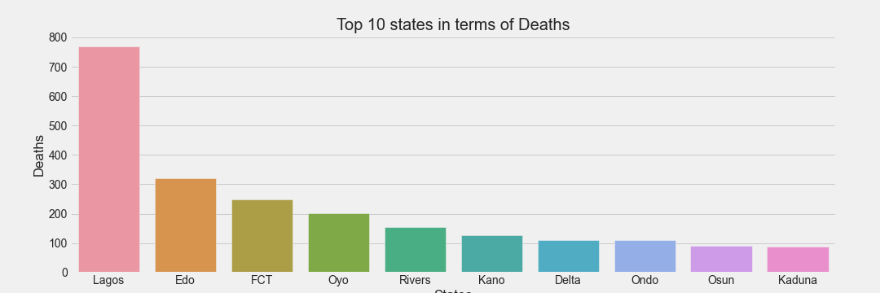
COVID-19 DEATH CASES BY TOP 10 STATES.

Slide 10
INSIGHTS SUMMARY
A line chart depicts the daily confirmed cases to be in an uptrend having higher highs and higher lows.
The daily recovered cases declined sharply to be constant after being in an uptrend.

Slide 11
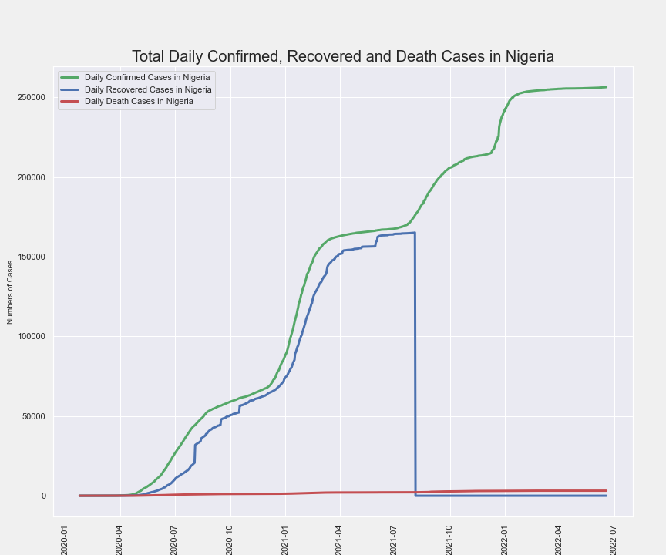
Total Daily Confirmed, Recovered and Death Cases

Slide 12
INSIGHTS SUMMARY
The maximum infection rate was 6198 .
The date of maximum infection rate was found to be 22-12-2021.
The daily infection rate is seen to have always surged around December/January – the festive periods.

Slide 13
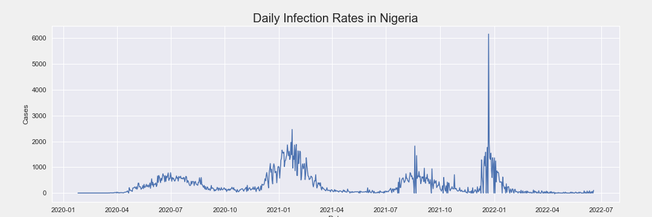
Daily Infection Rates

Slide 14
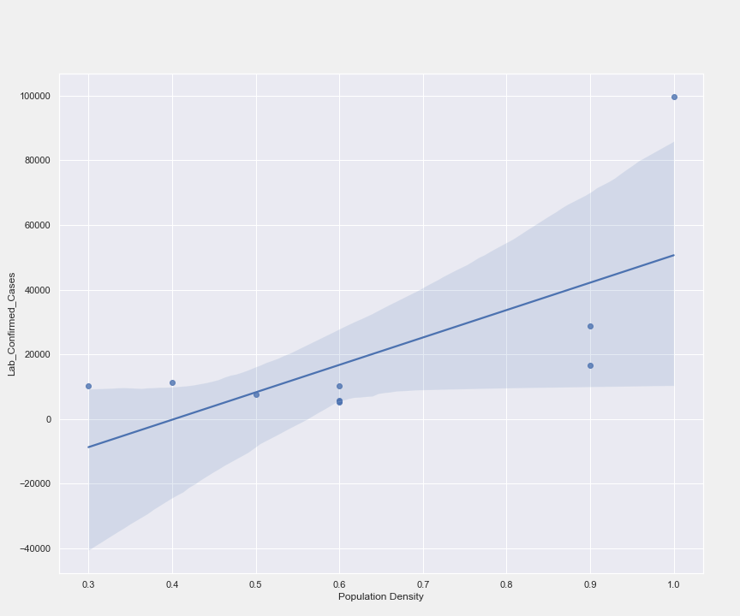
REGRESSION PLOT OF THE POPULATION DENSITY AGAINST THE CONFIRMED CASES

